Slide 1
Chapter 8
How to analyze the data

Slide 2
Objectives
Applied
Melt the data in two or more columns.
Group and aggregate the data in a DataFrame.
Pivot the data in a DataFrame or create a pivot table from the data.
Bin the data for a column.
Select the rows with the n largest values from a DataFrame, calculate the percent change for the rows in a column of a DataFrame, or rank the rows in a DataFrame by largest or smallest values.

Slide 3
Objectives (continued)
Knowledge
Distinguish between the pivot() and the pivot_table() methods.
Explain why binning the data in a column is useful.
Describe the way you can find other methods for specific analysis tasks.

Slide 4
The melt() method
Method | Description
melt(params) | Melts the data in two or more columns into two columns.
Parameters of the melt() method
Parameter | Description
id_vars | The column or columns that won’t be melted.
value_vars | The columns to melt. If none are specified, all will be melted.
var_name | The name of the column that will contain the melted column names, or “variable” by default.
value_name | The name of the column that will contain the melted column values, or “value” by default.

Slide 5
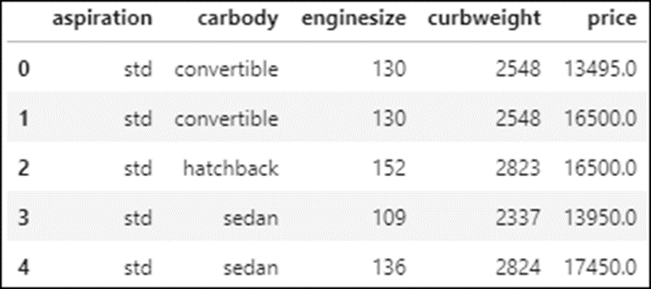
The cars DataFrame
cars.head()

Slide 6
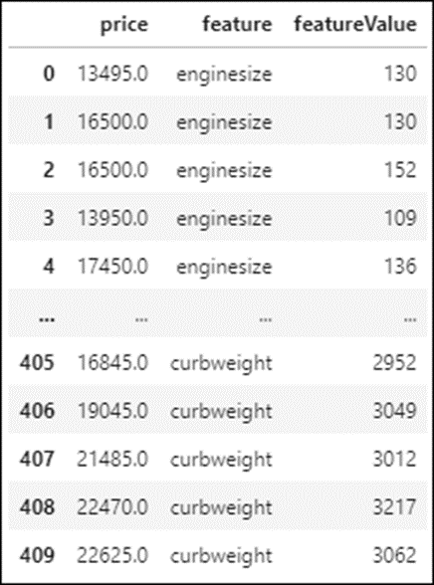
How to use the melt() method
cars_melted = pd.melt(cars, id_vars='price',
value_vars=['enginesize','curbweight'],
var_name='feature',
value_name='featureValue')
cars_melted

Slide 7
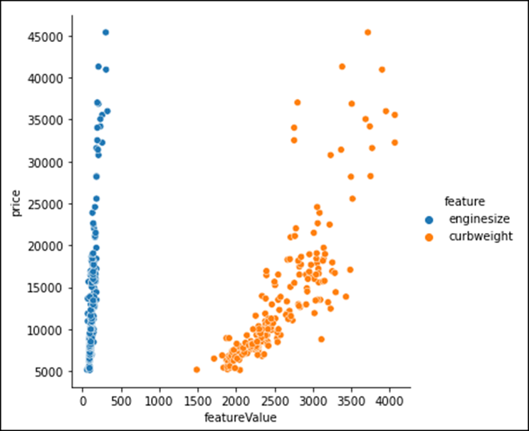
How to plot melted data with the hue parameter
sns.relplot(data=cars_melted, x='featureValue', y='price',
hue='feature')

Slide 8
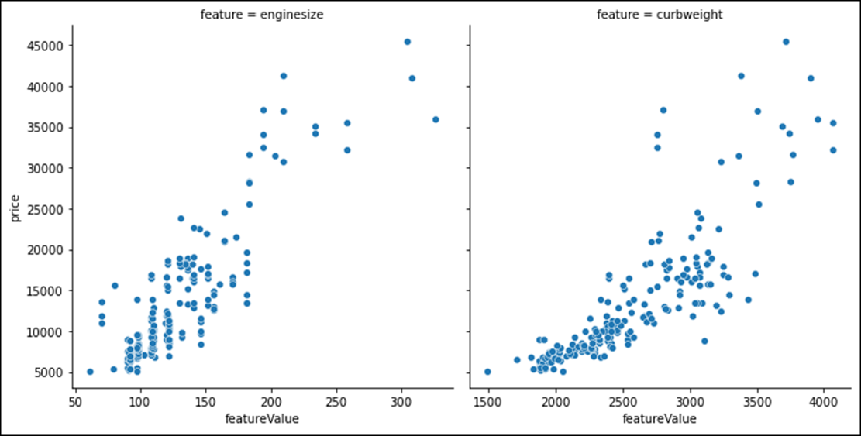
How to plot melted data with the col parameter
sns.relplot(data=cars_melted, x='featureValue', y='price',
col='feature', facet_kws={'sharex':False})

Slide 9
Some of the aggregate methods that are optimized for grouping
sum()
mean()
median()
count()
std()
min()
max()

Slide 10
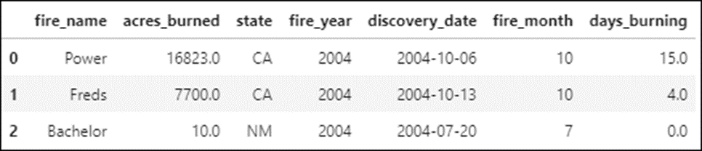
The fires DataFrame before the data is grouped
fires.head(3)

Slide 11
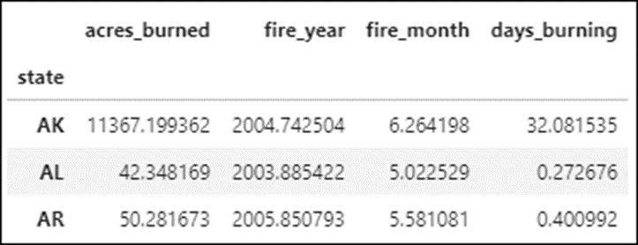
How to get the average for each numeric column in each state
fires.groupby('state').mean().head(3)

Slide 12
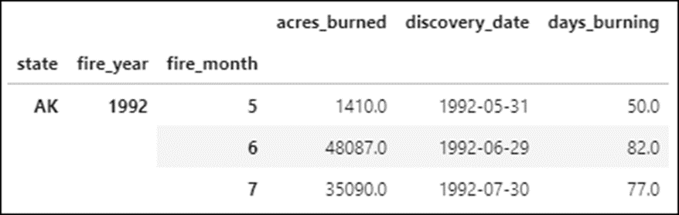
How to get the maximum value for each month in each state
fires.groupby(['state','fire_year','fire_month']) \
.max().dropna().head(3)

Slide 13
The groupby() method
Method | Description
groupby(params) | Returns a GroupBy object that supports aggregate methods such as sum().
Parameters of the groupby() method
Parameter | Description
by | The column or list of columns to group by.
as_index | If False, doesn’t create an index based on the groupby columns. If True (the default), it does.

Slide 14

The fires DataFrame
fires.head(3)

Slide 15
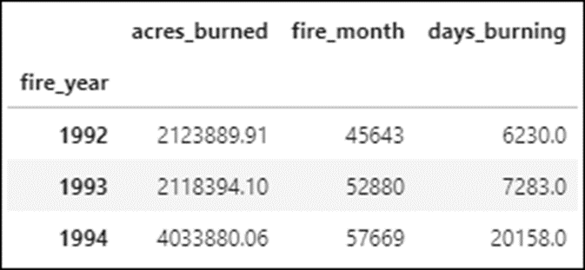
A GroupBy object with the fire_year column as the index
yearly_group = fires.groupby('fire_year')
yearly_sums = yearly_group.sum()
yearly_sums.head(3)

Slide 16
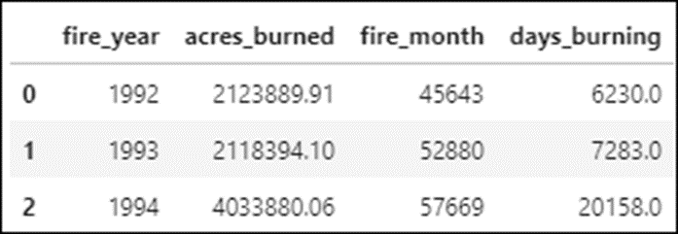
A GroupBy object without indexes
yearly_group = fires.groupby(
'fire_year', as_index=False).sum()
yearly_sums = yearly_group.sum()
yearly_sums.head(3)

Slide 17
The agg() method
Method | Description
agg() | Applies an aggregate method or list of methods to a Series or DataFrame object.

Slide 18
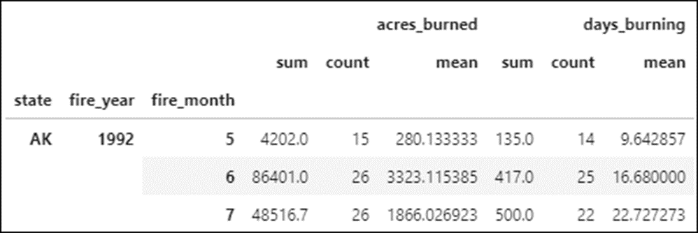
The GroupBy object
monthly_group = fires.groupby( ['state','fire_year','fire_month'])
How to apply aggregate methods to all numeric columns
monthly_group.agg(['sum','count','mean']).dropna().head(3)

Slide 19
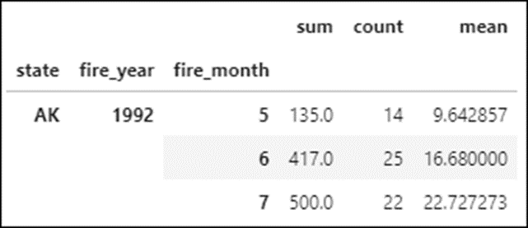
How to apply aggregate methods to a single column
monthly_group.days_burning.agg(
['sum','count','mean']).dropna().head(3)

Slide 20
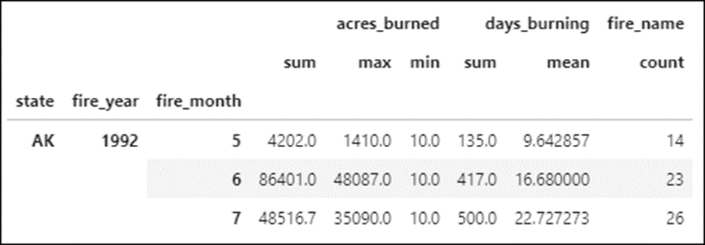
How to apply varied aggregate methods to numeric columns
df = monthly_group.agg({'acres_burned':['sum','max','min'],
'days_burning':['sum','mean'],
'fire_name':'count'}).dropna()
df.head(3)

Slide 21
The pivot() method
Method | Description
pivot(params) | Pivots the data based on the index, columns, and values parameters.
Parameters of the pivot() method
Parameter | Description
index | The column or list of columns to use as the row index (no duplicates).
columns | The column or list of columns to use as the column index.
values | The column or list of columns to use to populate the new DataFrame. By default, all remaining columns are used.

Slide 22
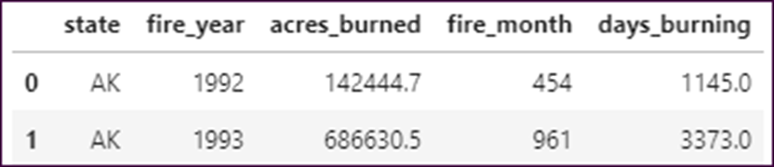
The top_states DataFrame
states = ['AK','CA','ID','TX']
top_states = fires.groupby(['state','fire_year'],
as_index=False).sum()
top_states = top_states.query('state in @states')
top_states.head(2)

Slide 23
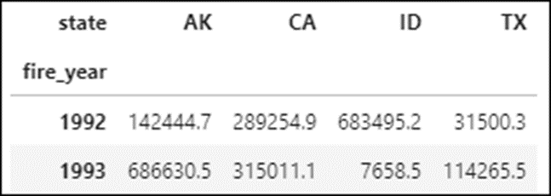
How to pivot the data
top_states.pivot(index='fire_year', columns='state',
values='acres_burned').head(2)

Slide 24
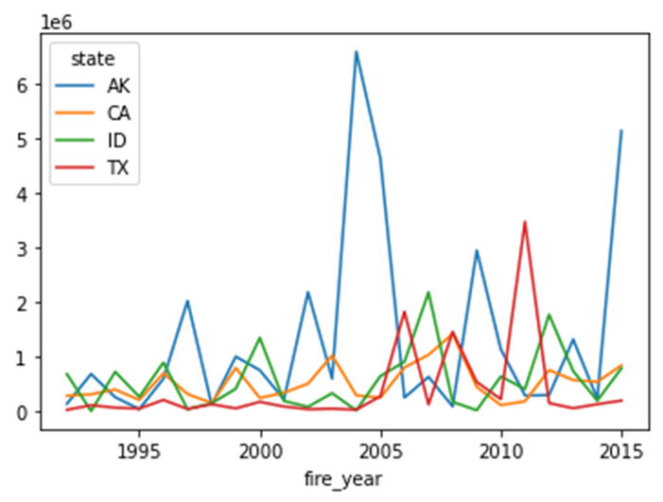
How to plot the data with the Pandas plot() method
top_states.pivot(index='fire_year', columns='state',
values='acres_burned').plot()

Slide 25
The pivot_table() method
Method | Description
pivot_table(params) | Produces a pivot table with an applied aggregate method.
Parameters of the pivot_table() method
Parameter | Description
index | The column or list of columns to use as the row index (allows duplicates).
columns | The column or list of columns to use as the column index.
values | The column or list of columns that contain the values to be aggregated. By default, all non-nuisance columns are aggregated.

Slide 26
Parameters of the pivot_table() method (cont.)
Parameter | Description
aggfunc | The aggregate method or list of methods to be applied to each column in the values parameter.
fill_value | The value to replace any missing values with in the resulting pivot table.

Slide 27
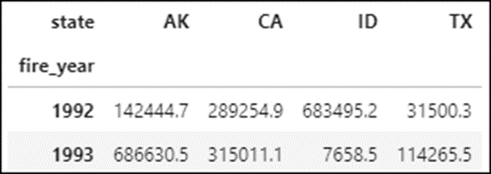
How to use the pivot_table() method to create a DataFrame
states = ['AK','CA','ID','TX']
fires_top_4 = fires.query('state in @states')
fires_top_4 = fires_top_4.pivot_table(index='fire_year',
columns='state', values='acres_burned', aggfunc='sum')
fires_top_4.head(2)

Slide 28
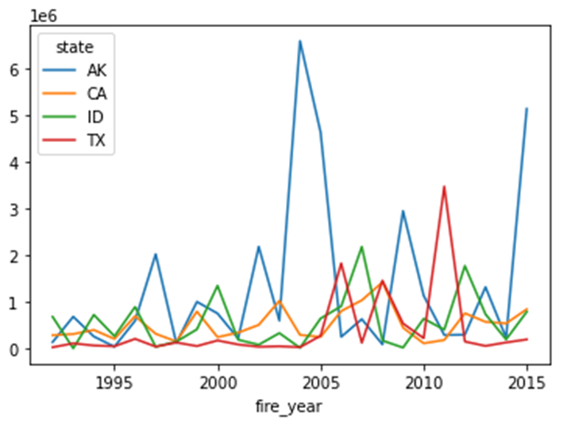
How to plot the data with the Pandas plot() method
fires_top_4.plot()

Slide 29
The cut() method
Method | Description
cut(params) | Bins the data into equal-sized bins.
Parameters of the cut() method
Parameter | Description
x | The column that contains the data to be binned.
bins | The number of bins to create, or a list of values for the bin edges.
labels | The labels to use for the bins.
right | If set to False, the right edges are not included in the bins.

Slide 30
The fires_filtered DataFrame
fires_filtered = fires.query( 'fire_year == 2010 and days_burning > 0').dropna()
How to create four bins for the data
pd.cut(fires_filtered.acres_burned, bins=4)
===========================================
1145154 (-296.103, 76535.75]
1145175 (-296.103, 76535.75]
...
1879725 (-296.103, 76535.75]
1880370 (-296.103, 76535.75]
Name: acres_burned, Length: 1858, dtype: category
Categories (4, interval[float64]): [(-296.103, 76535.75] < (76535.75, 153061.5] < (153061.5, 229587.25] < (229587.25, 306113.0]]

Slide 31
How to add labels to the bins
pd.cut(fires_filtered.acres_burned, bins=[0,100000,200000,300000,400000],
labels=['small','medium','large','very large'])
===================================================
1145154 small
1145175 small
...
1879725 small
1880370 small
Name: acres_burned, Length: 1858, dtype: category
Categories (4, object): ['small' < 'medium' < 'large' < 'very large']

Slide 32
The distribution of values in the bins
pd.cut(fires_filtered.acres_burned, bins=[0,100000,200000,300000,400000],
labels=['small','medium','large','very large']).value_counts()
==================================================================
small 1855
medium 2
very large 1
large 0
Name: acres_burned, dtype: int64

Slide 33
The qcut() method
Method | Description
qcut(params) | Bins the data into quantiles with the same number of unique values in each bin. The number of rows in each bin will be skewed if there are duplicates.
Parameters of the qcut() method
Parameter | Description
x | The column that contains the data to be binned.
q | The number of quantiles to create.
labels | The labels to use for the bins.
duplicates | What to do with bins that have the same edges. The default is raise, which raises a ValueError. If set to drop, the non-unique bins are dropped.

Slide 34
How to use four quantiles to bin the data
pd.qcut(fires_filtered.acres_burned, q=4,
labels=['small','medium','large','very large'])
=======================================================
1145154 medium
1145175 very large
...
1880209 small
1880370 large
Name: acres_burned, Length: 4882, dtype: category
Categories (4, object): ['small' < 'medium' < 'large' < 'very large']

Slide 35
The distribution of the values in each bin
pd.qcut(fires_filtered.acres_burned, q=4,
labels=['small','medium','large','very large']).value_counts()
======================================================================
medium 1227
small 1221
very large 1220
large 1214
Name: acres_burned, dtype: int64

Slide 36
How to assign bin labels to a new column
fires_filtered['fire_size'] = pd.qcut( fires_filtered.acres_burned, q=4,
labels=['small','medium','large','very large'])

Slide 37
A qcut() method that drops duplicate bins
pd.qcut(fires_filtered.days_burning, q=4,
labels=['short','medium','long'],
duplicates='drop').value_counts()
=========================================
short 1018
long 433
medium 407
Name: days_burning, dtype: int64

Slide 38
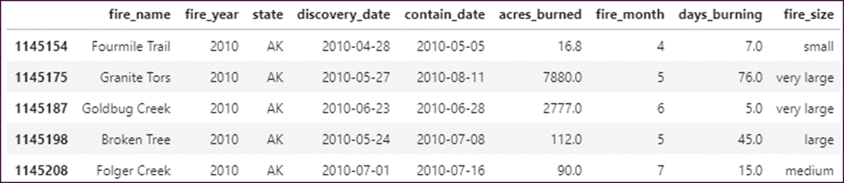
The DataFrame with a fire_size column that bins the data
fires_filtered.head()

Slide 39
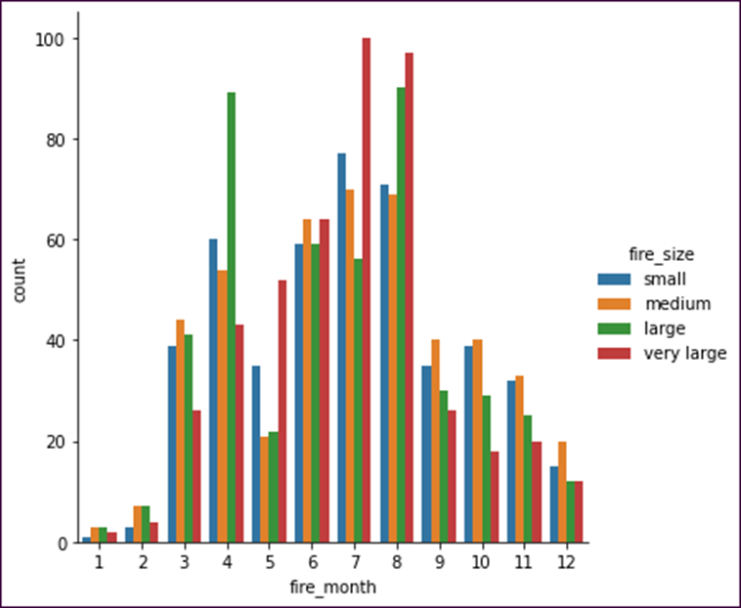
How to plot the binned data
sns.catplot(data=fires_filtered, kind='count',
x='fire_month', hue='fire_size')

Slide 40
The nlargest() method
Method | Description
nlargest(params) | Returns the first n rows with the largest values in the specified columns.
Parameters of the nlargest() method
Parameter | Description
n | The number of rows to return.
columns | The columns that determine which rows to keep.
keep | The rows to keep in the event of a tie. Possible values: first, last, and all. The default is first.

Slide 41
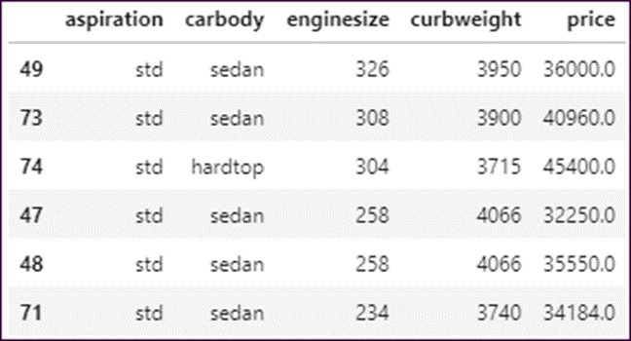
How to use the nlargest() method
cars.nlargest(n=6, columns='enginesize')

Slide 42
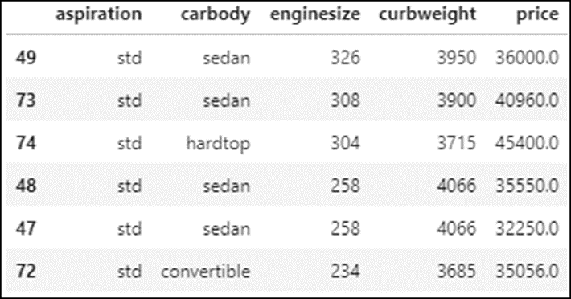
Another nlargest() example
cars.nlargest(n=6, columns=['enginesize','price'])

Slide 43
The pct_change() method
Method | Description
pct_change() | Calculates the percent change from the previous row to the current row for a DataFrame or Series object.

Slide 44
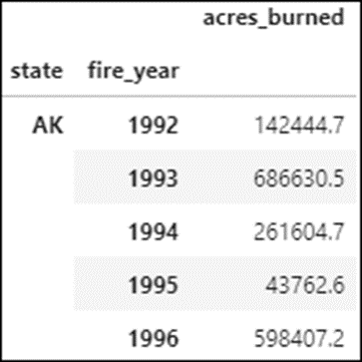
The fires data
df = fires[['state','fire_year','acres_burned']] \
.groupby(['state','fire_year']).sum()
df.head()

Slide 45
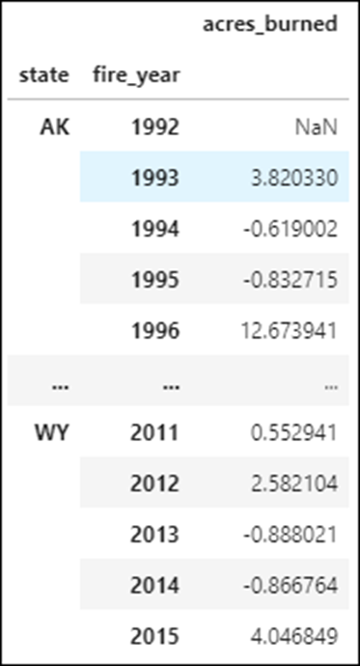
How to use the pct_change() method
df.pct_change()

Slide 46
The rank() method
Method | Description
rank(params) | Computes numerical data ranks (1 through n) along an axis.
Parameters of the rank() method
Parameter | Description
ascending | If False, ranks in descending order. If True (the default), ranks in ascending order.
method | How to rank the group of records that have ties. Possible values include average (the default), min, max, first, and dense.
pct | If True, displays the rankings in percentile form. False is the default.

Slide 47
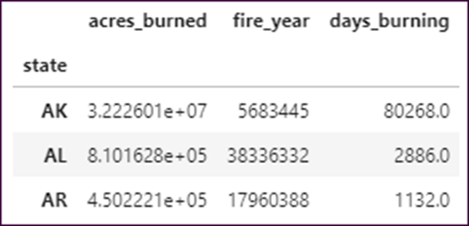
The state totals
df = fires.groupby('state').sum() \
[['acres_burned','fire_year','days_burning']]
df.head(3)

Slide 48
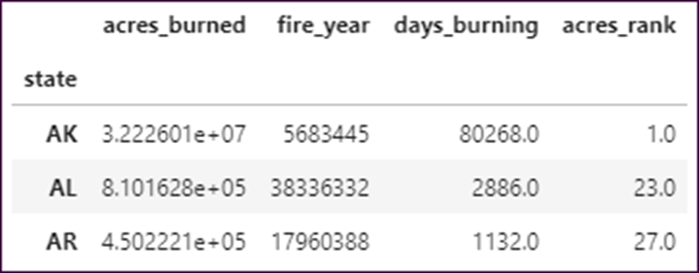
How to add an acres_rank column based on acres burned
df[acres_rank'] = df.acres_burned.rank(ascending=False)
df.head(3)

Slide 49
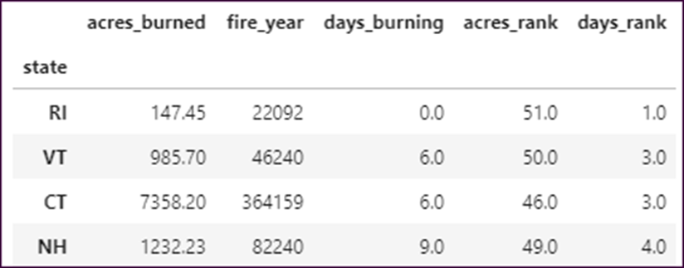
How to add a days_rank column based on days burning
df['days_rank'] = df.days_burning.rank(method='max')
df.sort_values('days_burning').head(4)

Slide 50
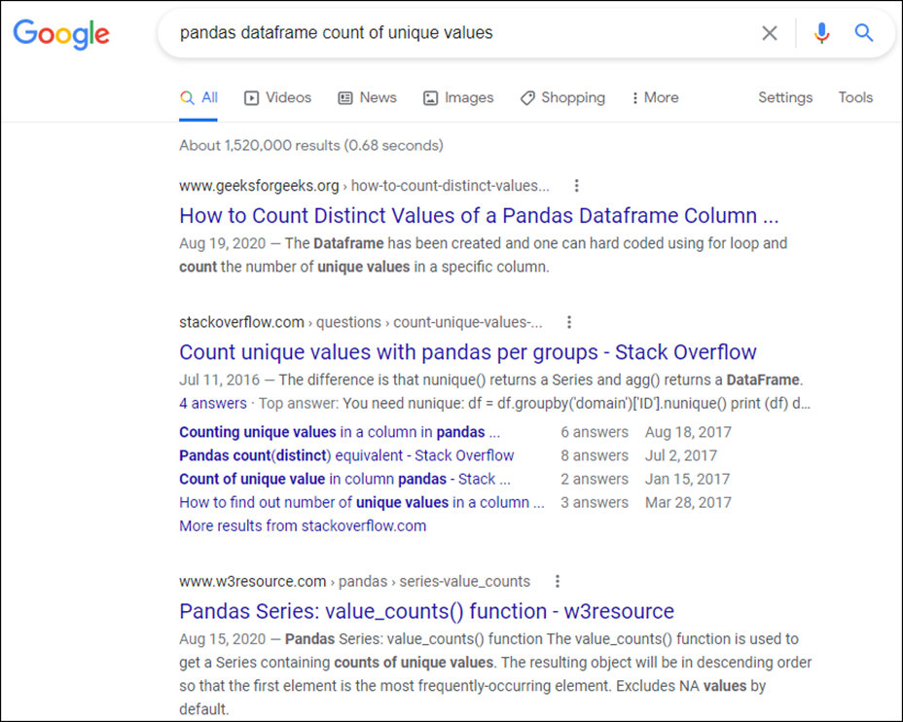
A Google search for a way to count the unique values in a column

